Slide 1
Steam Boilers

Slide 2
Steam Boilers
Definition of a Boiler
Boiler is defined as a closed metallic vessel in which the water is converted into steam above the atmospheric pressure by the application of heat generated by the combustion of fuels.
Function of a Boiler
The function of a boiler is to generate & supply the steam at the required constant pressure with its quality either dry, wet or superheated.

Slide 3
Classification of Boilers
According to the axis of the shell:
Horizontal boiler
Vertical boiler
Inclined boiler
According to the application
Stationary boiler
Mobile boiler
According to the location of the furnace
Internally fired boiler
Externally fired boiler
SHELL
SHELL
Furnace
Furnace

Slide 4
According to the type of fuel used
Solid fueled boiler
Liquid fueled boiler
Gaseous fueled boiler
According to the method of circulation of water
Natural circulation boiler (circulation of water due to difference in temperature)
Forced circulation boiler (pumps are used)
According to the flow of water and flue gases
Fire tube boilers
Water tube boilers

Slide 5
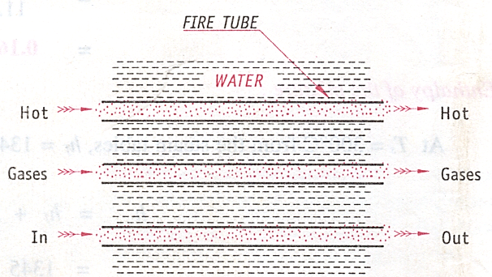
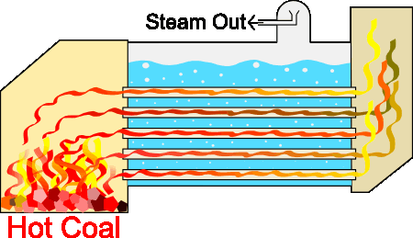
Fire Tube Boiler
In the fire tube boilers, the hot flue gases produced by the combustion of fuels are led through a nest of tubes around which the water circulates.
Example:
Lancashire boiler.
Ref: http://www.icym.edu.my/v13/about-us/our-news/general/1194-fire-tube-boiler.html

Slide 6
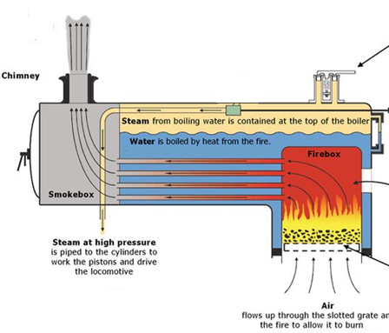
Locomotive boiler (Fire Tube Boiler)

Slide 7
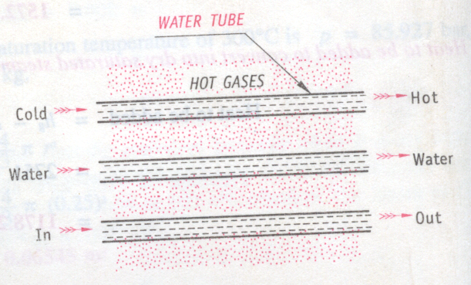
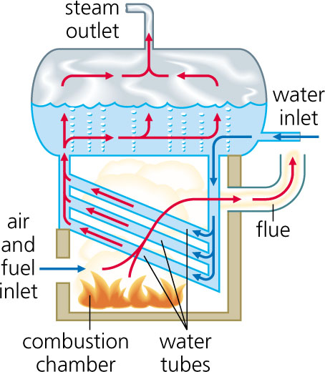
Water Tube Boiler:
In the water tube boilers, the water flows through the tubes while the hot gases produced by the combustion of the fuels pass around them externally
Example:
Babcock and Wilcox Boiler

Slide 8
Babcock & Wilcox boiler
(Water tube boiler)
It is a horizontal, stationary, externally fired, natural circulation, water tube boiler.
By using this boiler, we can get steam up to a pressure of 75 – 80 bar.
Application:
It is widely used in thermal power stations.

Slide 9
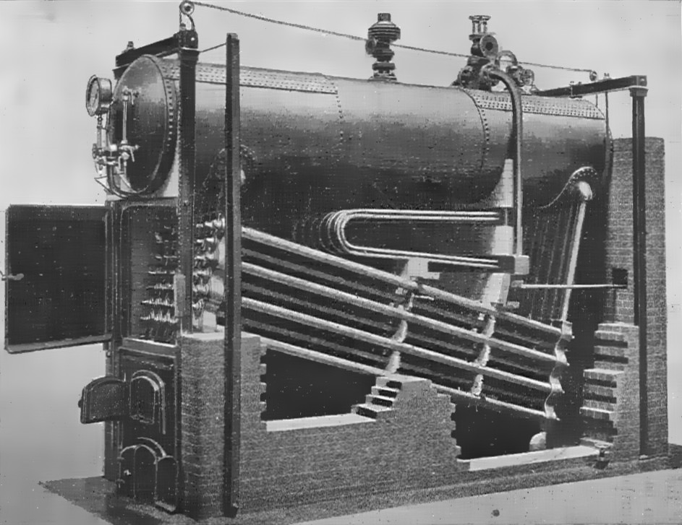
Babcock and Wilcox boiler
Water drum/ shell
Water tubes

Slide 10
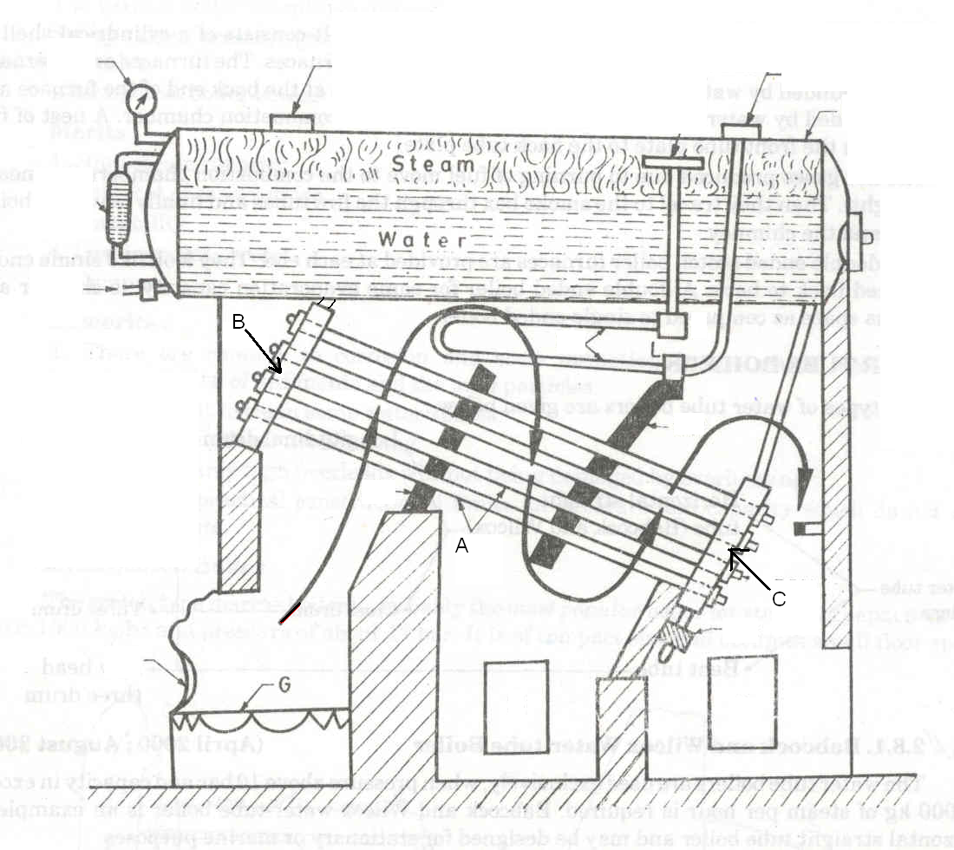
Babcock and Wilcox boiler
T
Q
L
P
A: Water tubes
B: Uptake header
C: Down take header
D: Boiler drum
E: Steel Caps
F: Mud Box
G: Dampers
H: Doors
J: Chain grate stoker
K: Furnace door
L: ‘T’ tube
M: Lower junction box
N: Upper junction box.
O: Stop valve connection
D
O
R
V
N
s
E
M
W
F
K
J
G
H
X
P: Stop valve, Q: Safety valve, R: Water-level indicator, S: Super heater,
T: Pressure gauge, V: Feed check valve, W: Baffles, X: Blow off valve

Slide 11
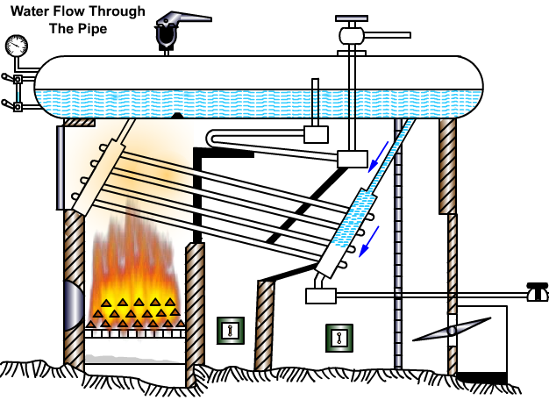
Water circuit in the boiler

Slide 12
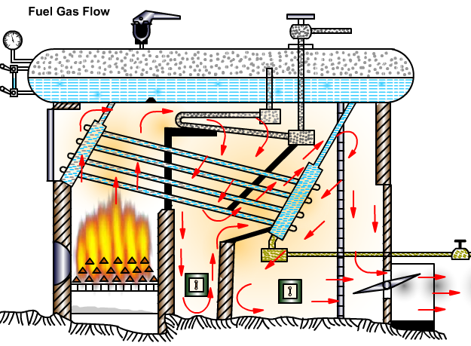
Path of flue gases

Slide 13
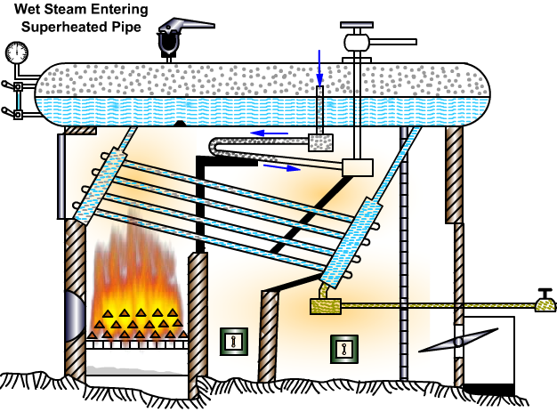
Superheating of the steam

Slide 14
Advantages of Water Tube Boilers over Fire Tube Boilers
Rapid steam generation
Generation of steam at higher pressures
Higher steam generation capacity
Sediment deposition is less
Suitable for any type of fuel
Occupies less space per unit power generation
Easy maintenance.

Slide 15
Disadvantages of Water Tube Boilers
over Fire Tube Boilers
Not suitable for mobile application
Treatment (Filtering/Softening) of water is necessary
High initial cost

Slide 16
Differences / Comparison between Fire tube and Water tube boilers
Particulars
Fire tube
Water tube
Flow of water & hot gases
Hot gases inside the tubes and water outside the tubes
Water inside the tubes and hot gases outside the tubes
Mode of firing
Internally fired
Externally fired
Operating pressure
Low
(Up to 15 bar)
High
( Up to 75 bar)
Rate of steam production
Low
High

Slide 17
Differences / Comparison
Particulars
Fire tube
Water tube
Applications
Suitable for chemical & sugar industries & not for power generation
Ideally suitable for power generation plants.
Safety
Safe, due to low pressure
Not safe, due to high pressure
Treatment of water
Not essential
Essential
Shell diameter
Large for given capacity
Small for given capacity

Slide 18
Boiler Mountings and Accessories
Mountings are mandatory and are required:
To have complete control over the steam generation,
Measurement of some of the important steam properties,
To provide safety to the boiler.
They are mounted directly on the boiler and become an integral part of the same.

Slide 19
Boiler Mountings
Water level indicators
Pressure gauge
Safety valves
Steam stop valve
Blow-off valve
Feed check valve
Fusible plug
Manhole & Mud Box

Slide 20
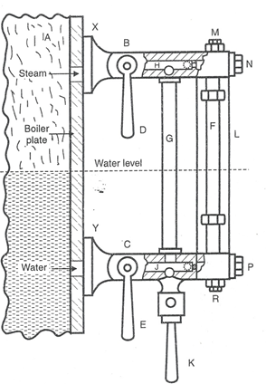
Functions of Boiler Mountings
Water Level Indicator:
It is used to indicate the level of water inside the boiler drum, and thereby guide the boiler attendant to maintain a constant level of water in the boiler drum.
Pressure Gauge:
It is used to indicate the pressure of steam inside the boiler drum.

Slide 21
Functions of Boiler Mountings
Safety Valve :
The function of the safety valve is to prevent the steam pressure in the boiler from exceeding a certain predetermined value.
Steam Stop Valve:
It is used to regulate the flow of steam from the boiler drum to the steam pipe or from one steam pipe to another.
Safety Valve
Stop Valve

Slide 22
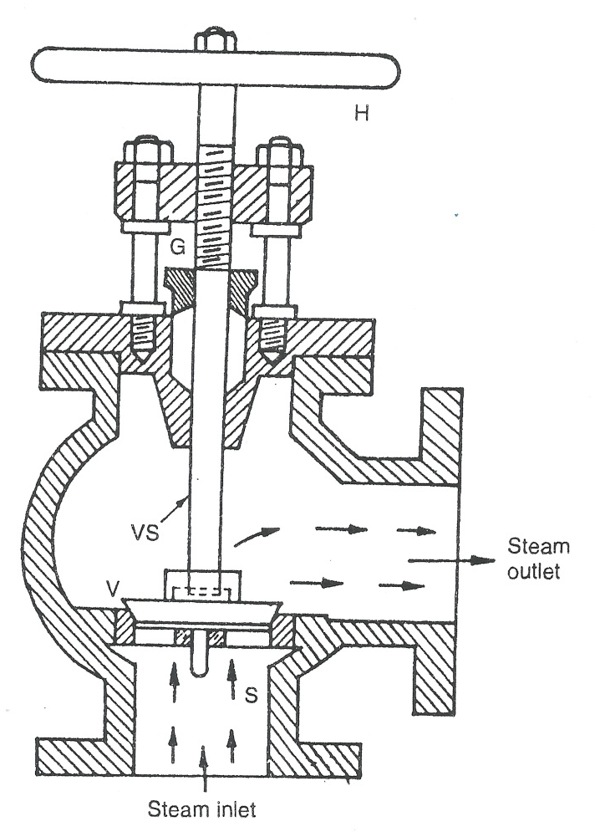
Steam Stop Valve
Hand wheel

Slide 23
Blow off Valve:
The function of the blow off valve is to remove the sediments collected at the bottom of the boiler periodically while in operation & also to empty water from the boiler for periodical cleaning and maintenance.
Blow off Valve

Slide 24
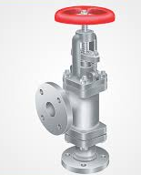
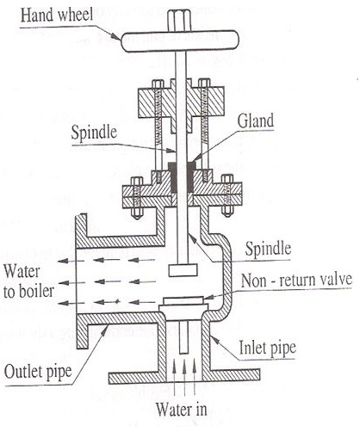
Feed Check Valve:
It is a non return valve and performs the dual function of regulating the flow of water to the boiler when the level of water inside the boiler drum falls and prevents the return flow of water from the boiler drum when the feed pump stops or in the event of failure of feed pump.

Slide 25
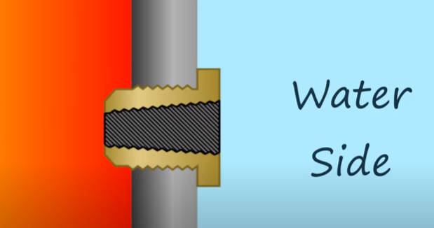
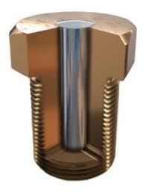
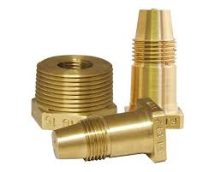

Fusible Plug:
It is used to extinguish the fire in the furnace of the boiler when the water level falls too much below the normal level. It protects the boiler against damage due to over heating caused by low water level.
Normal condition
Brass
Overheated condition
Fusible alloy (Tin)
Ref: https://www.youtube.com/watch?v=fVIu4-IPyY8

Slide 26
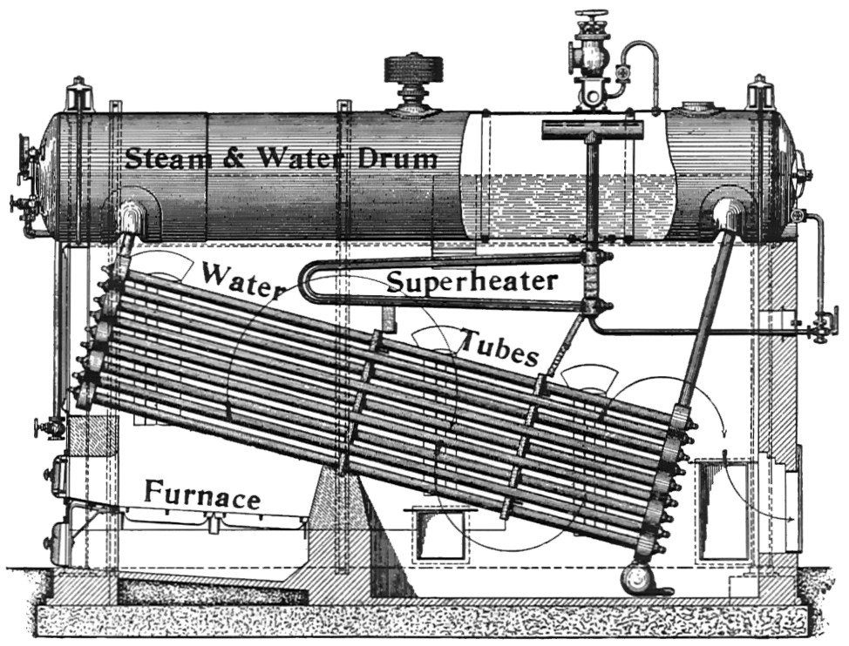
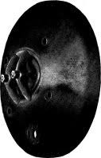
Manhole:
It is an opening in the boiler shell through which a person can go in for periodic inspection and cleaning. It is elliptical in shape.
Oval shaped Manhole Plate

Slide 27
They are used to improve the efficiency of the boiler and hence the steam power plant.
They are not mandatory and are not mounted directly on the boiler. The essential boiler accessories are:
Economizer
Air-preheater
Superheater
Steam separator
Steam trap
BOILER ACCESSORIES

Slide 28
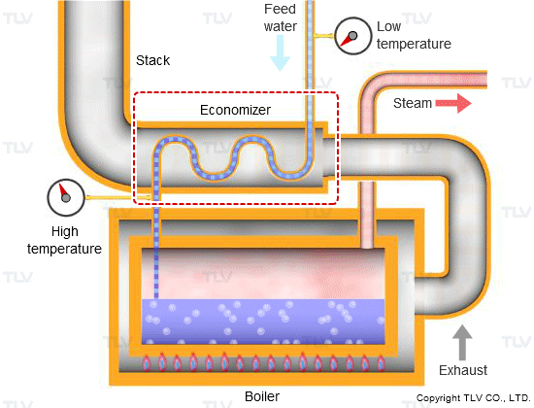
Functions of Boiler Accessories
Economizer:
The function of the economizer is to increase the temperature of feed water. It is a device in which the waste heat of the flue gases is utilized for preheating the feed water thereby increasing its sensible heat.

Slide 29
Functions of Boiler Accessories
Air preheater:
It is a accessory which is used for preheating the air supplied to the furnace of the boiler.
It uses the waste heat of the flue gases for preheating the air, which accelerates the combustion process of the fuel thereby improving the boiler efficiency.
Air pre-heater
Atmospheric air entry
Pre-heated
air supply to boiler furnace

Slide 30
Functions of Boiler Accessories
Super heater:
It is used to increase the temperature of the steam beyond the saturation temperature thereby increasing its enthalpy. It is fitted outside the boiler drum. Generally it uses the same heat source of the boiler.

Slide 31
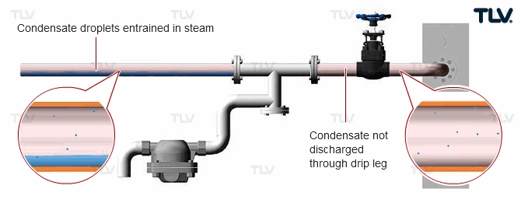
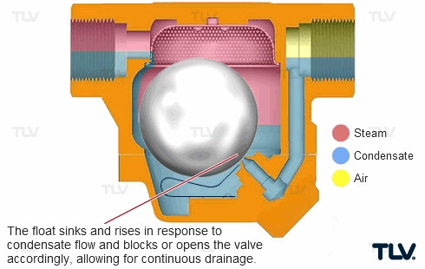
Steam Trap
It is a device which is used to drain off the condensed water accumulating in the steam pipe lines by ensuring no escape of pressure steam out of it.
steam condensate to be removed
steam condensate removed
Ref: https://www.tlv.com/global/TI/steam-theory/mechanical-steam-traps.html

Slide 32
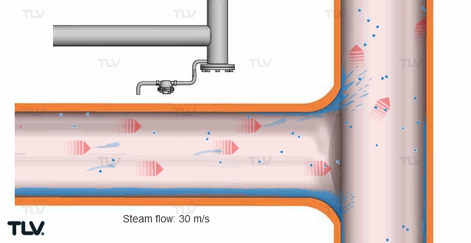
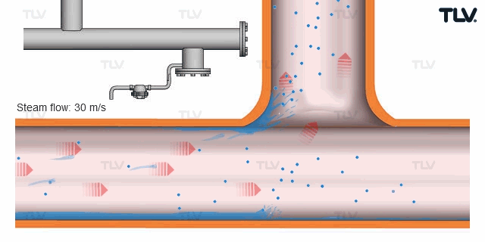
Steam Seperator
It separates the entrained water droplets from the steam flowing in the pipe lines. It is installed very close to the turbine room.
Entrained water droplets not removed by steam trap
Steam trap
Ref: https://www.tlv.com/global/TI/steam-theory/mechanical-steam-traps.html

Slide 33
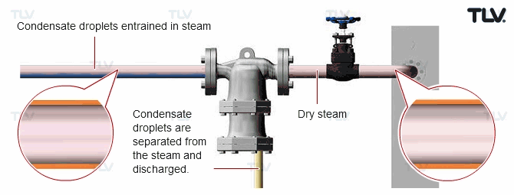
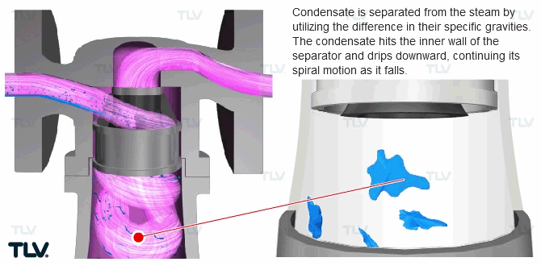
Steam seperator

Slide 34
Differences between Boiler mountings & Accessories
Boiler mountings | Boiler accessories
They are mandatory
They are optional
They are related to proper functioning, maintenance and safety of the boilers.
They are related to efficiency & economy of the boilers.
They are not fitted directly on the boiler drum
They are fitted directly on the boiler drum.
They are also used to measure some of the important properties
They are used to improve some of the important properties

